Slide 1
Integrated Services Digital Network
ISDN
Services
History
Subscriber Access
Layers
BISDN

Slide 2
Services
Goal: provide fully integrated digital services to users. These services fall into three categories:
  Bearer Services: Provide the means to transfer information without the network manipulating the content of that information. (Layers 1, 2, and 3 of OSI).
  Teleservices: The may alter the contents of the data (layers 4-7 of the OSI model).
  Supplementary Services: Provide additional functionality to the bearer services and teleservices such as call waiting, reverse charging, and message handling.

Slide 3
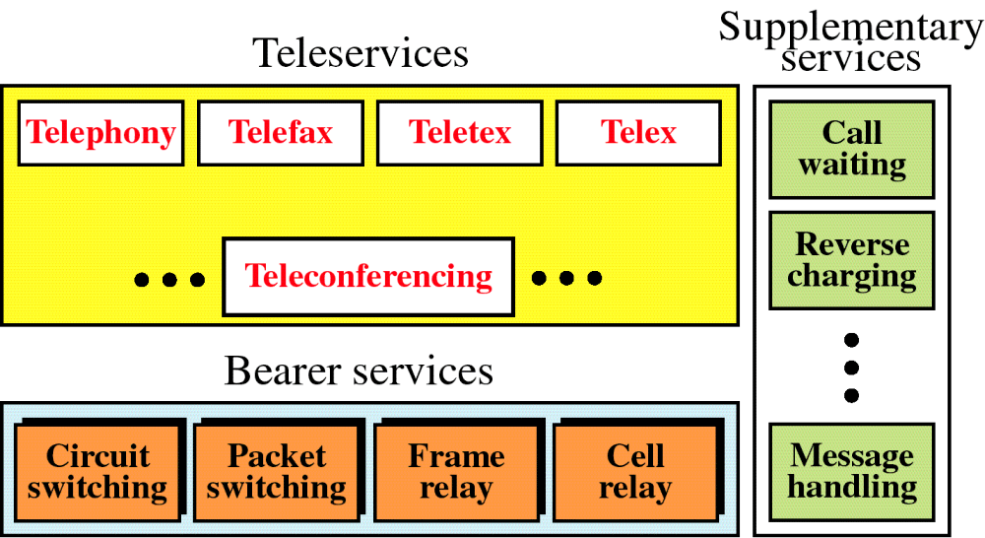
Figure 15-1
ISDN Services
WCB/McGraw-Hill
© The McGraw-Hill Companies, Inc., 1998

Slide 4
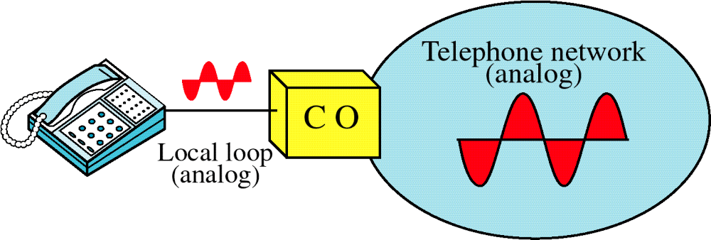
Figure 15-2
Voice over Analog Network

Slide 5
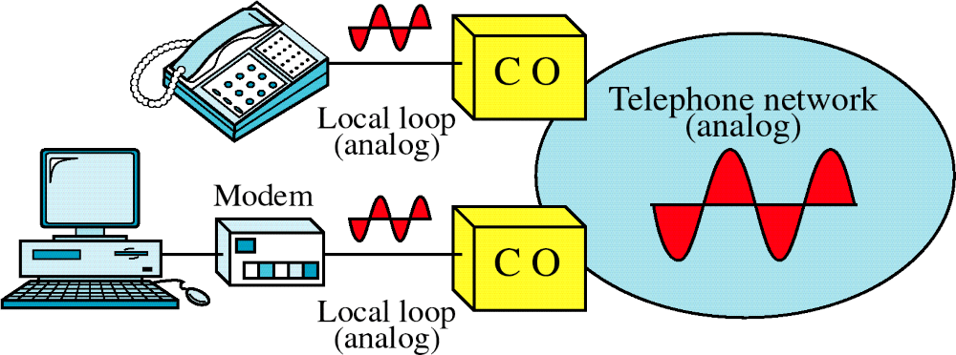
Figure 15-3
Voice and Data over Analog Network

Slide 6
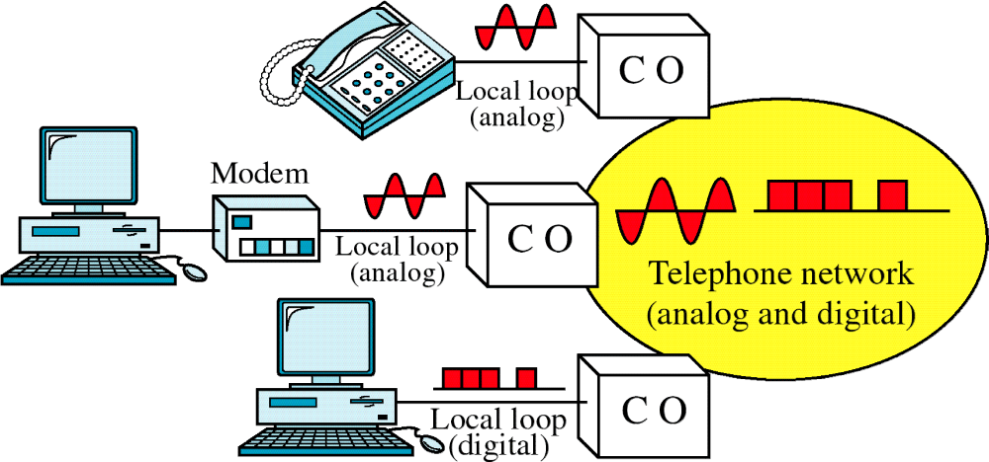
Figure 15-4
Analog and Digital Services

Slide 7
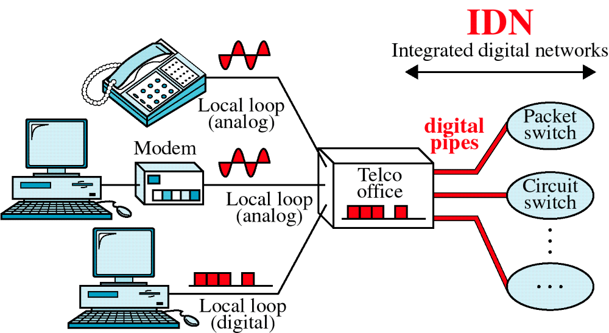
Figure 15-5
Integrated Digital Network

Slide 8
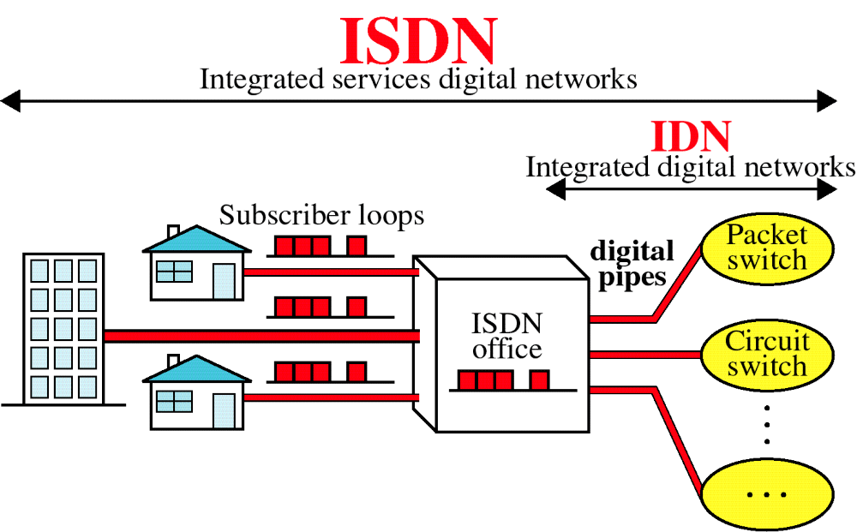
Figure 15-6
Integrated Services Digital Network
All communication connections occur via a single interface

Slide 9
Channel Types
Three channel types:
  Bearer channels (B) (64 Kbps): the basic user channel, full duplex, several transmissions can be multiplexed if they are destined for a single recipient (end-to-end transmission).
  Data channels (D) (16 or 64 Kbps), its primary function is to carry control signaling for the B channels (call establishment, ringing, …). It can be used to transmit low-rate data transfer.
  Hybrid channels (H) (384, 1536, 1920 Kbps) for high data rate applications.

Slide 10
User Interface
Basic Rate Interface (BRI) specifies a digital pipe consisting of two B-channels and one 16 Kbps D-channel (2B+D). The service requires an additional 48 Kbps of operating overhead.
  Residential and small-office customers.
  Can use the same twisted-pair local loop.

Slide 11
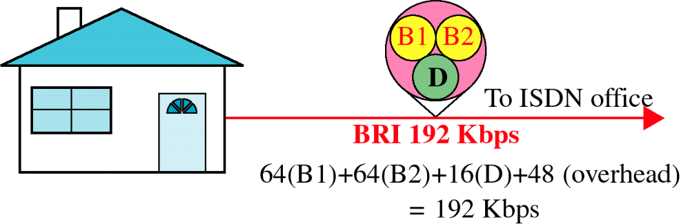
Figure 15-7
Basic Rate Interface
WCB/McGraw-Hill
© The McGraw-Hill Companies, Inc., 1998

Slide 12
User Interface
Primary rate interface (PRI): 23 B channels and one 64-kbps D channel. The PRI service require an 8 kbps of overhead.
  1.544 mbps (same as T-1)
  In Europe, 30 B + 2 D (2.048 mbps –E-1)
  Other channel combinations are also supported by the PRI standard.
  The B channels can be shared.

Slide 13
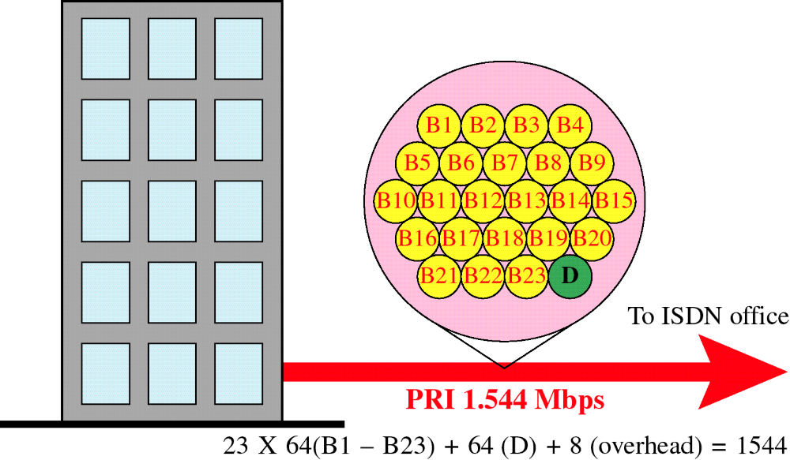
Figure 15-8
Primary Rate Interface
WCB/McGraw-Hill
© The McGraw-Hill Companies, Inc., 1998

Slide 14
Functional Grouping
Devices that support ISDN services are described by their functional grouping.
Standard defines only the functional behavior of each group.
Functional grouping include network termination 1 and 2, terminal equipment 1 and 2, and terminal adapters.

Slide 15
Network Termination 1 (NT1) is a device that controls the physical and electrical termination of the ISDN at the user premise and connects the user’s internal system to the digital subscriber loop.
Network Termination 2 (NT2) is a device that performs functions at the first three layers of the OSI model (multiplexing, flow control, and packetizing). It is used primarily to interface between a multiuser system and NT1. Different devices can be an NT2 especially PBX and LANs.

Slide 16
Terminal Equipment 1 (TE1): is a standard ISDN peripheral such as digital telephones, integrated voice/data terminals, …
Terminal Equipment 2 (TE2): is any non-ISDN device such as terminals, workstations, …
Terminal Adaptor (TA): is device that connects TE2 to to an ISDN network.
Reference points: a label used to identify individual interfaces between two elements of and ISDN installation.
A reference point defines how two network elements must be connected and the format of the traffic between them.

Slide 17
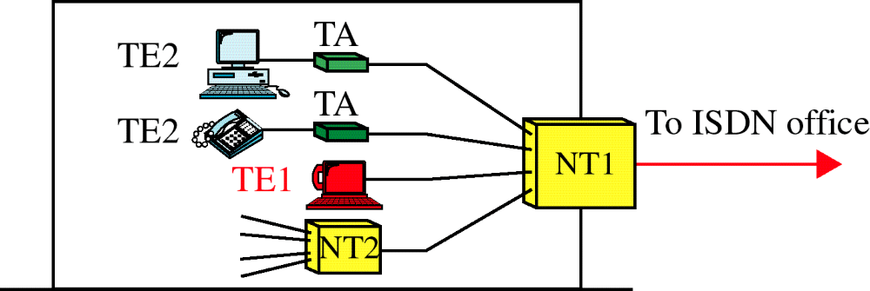
Figure 15-9
Functional Grouping
WCB/McGraw-Hill
© The McGraw-Hill Companies, Inc., 1998

Slide 18
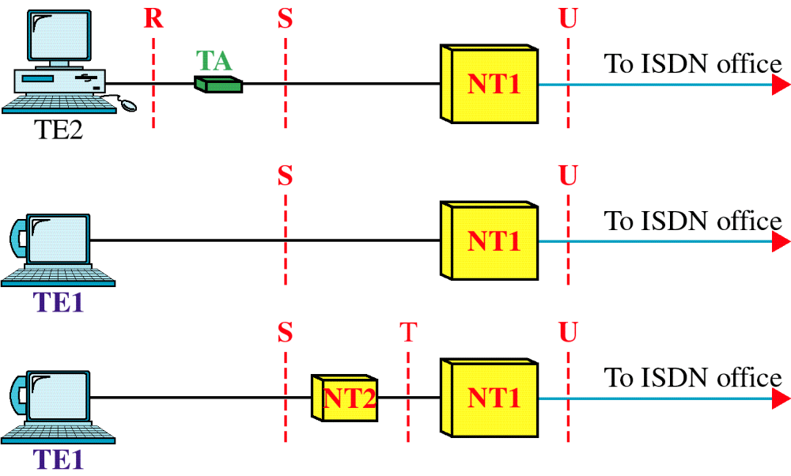
Figure 15-10
Reference Points
WCB/McGraw-Hill
© The McGraw-Hill Companies, Inc., 1998

Slide 19
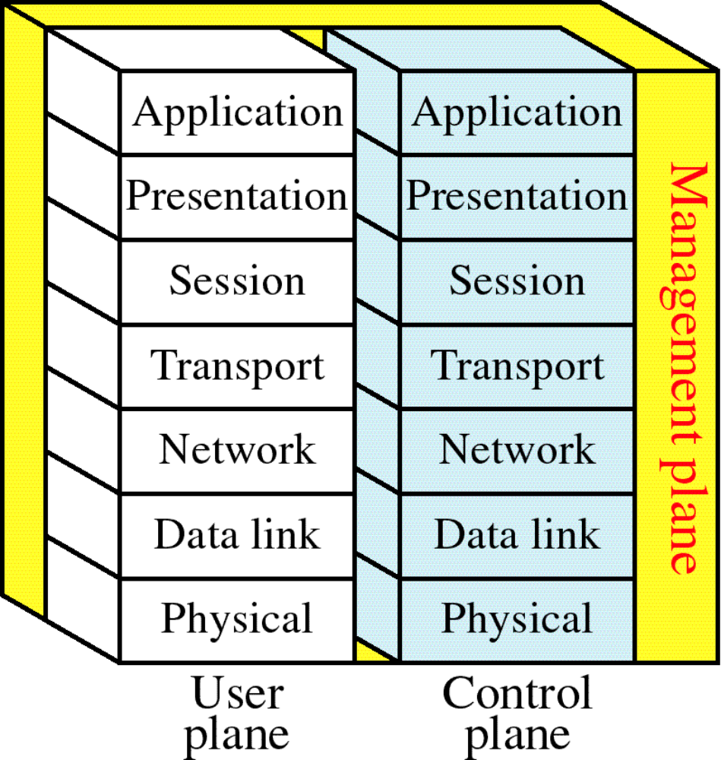
Figure 15-11
ISDN Layers
WCB/McGraw-Hill
© The McGraw-Hill Companies, Inc., 1998

Slide 20
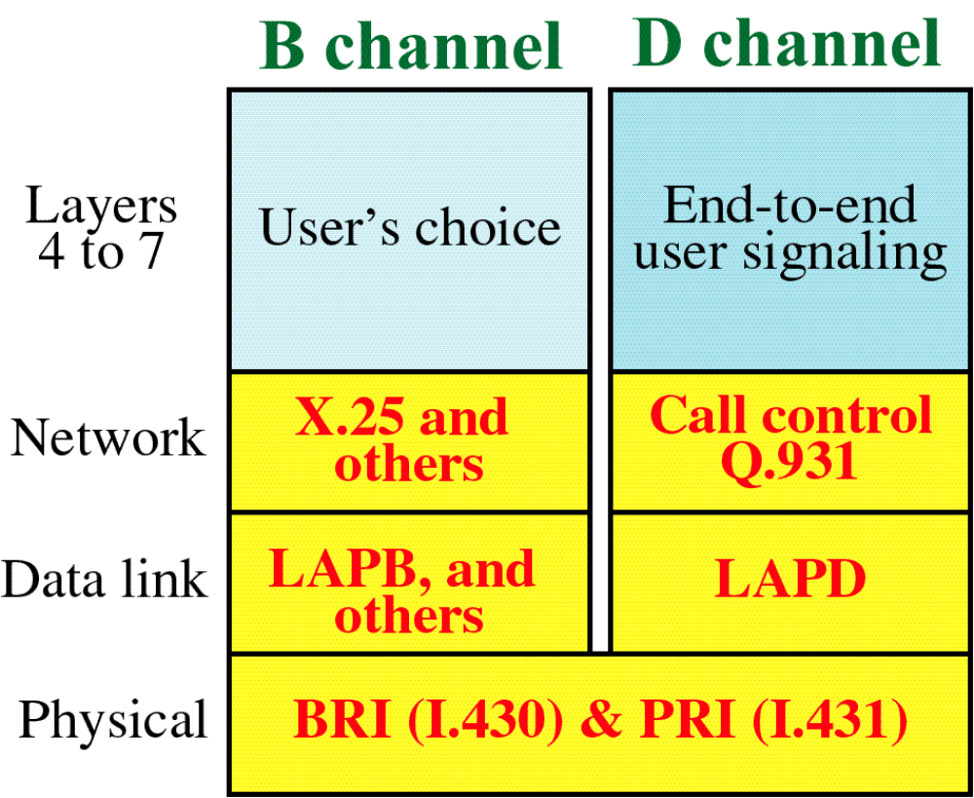
Figure 15-12
ISDN Layers for B and D Channels
WCB/McGraw-Hill
© The McGraw-Hill Companies, Inc., 1998

Slide 21
Physical Layer
R Interface: not defined by the ISDN.
S Interface: ITU-T standard ISO8887 calls for two to three-pair TP.
Encoding is pseudoternary.
U Interface: a single pair TP cable in each direction. Encoding is 2B1Q.

Slide 22
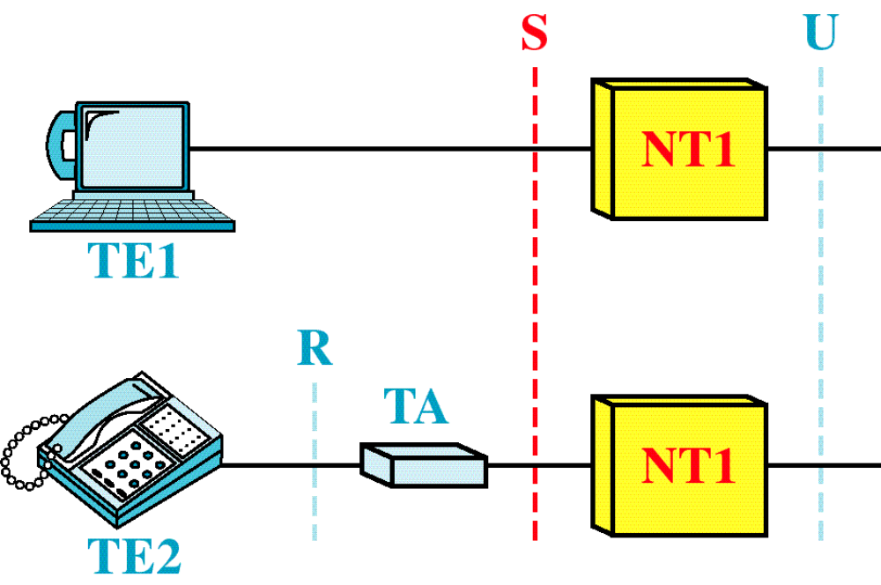
Figure 15-13
BRI Interfaces
WCB/McGraw-Hill
© The McGraw-Hill Companies, Inc., 1998

Slide 23
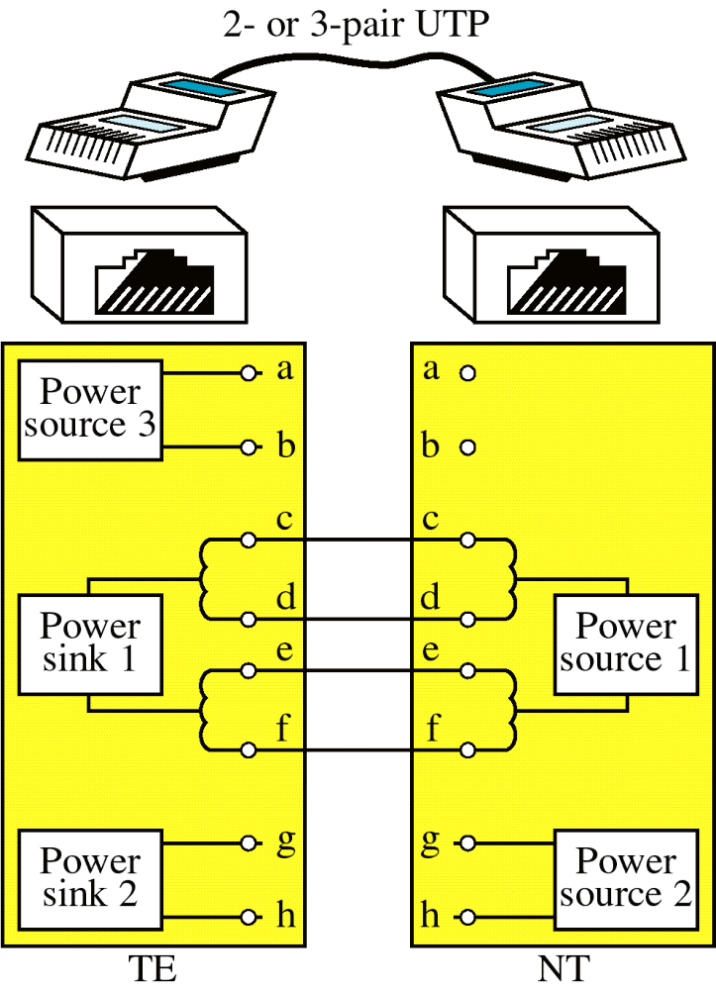
Figure 15-14
S Interface
WCB/McGraw-Hill
© The McGraw-Hill Companies, Inc., 1998

Slide 24
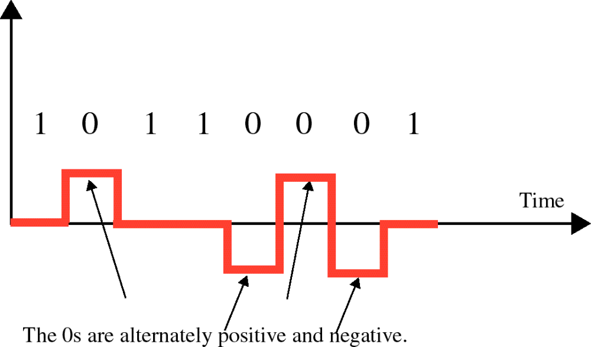
Figure 15-15
Pseudoternary Encoding
WCB/McGraw-Hill
© The McGraw-Hill Companies, Inc., 1998

Slide 25
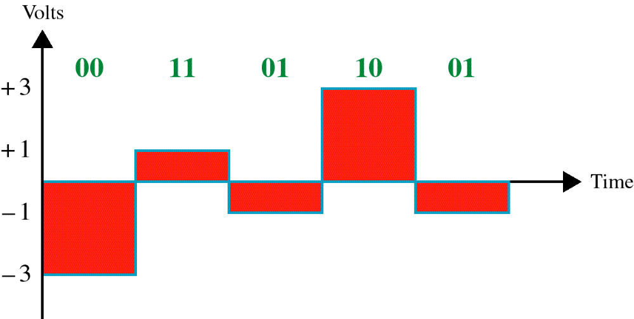
Figure 15-16
2B1Q Encoding
WCB/McGraw-Hill
© The McGraw-Hill Companies, Inc., 1998

Slide 26
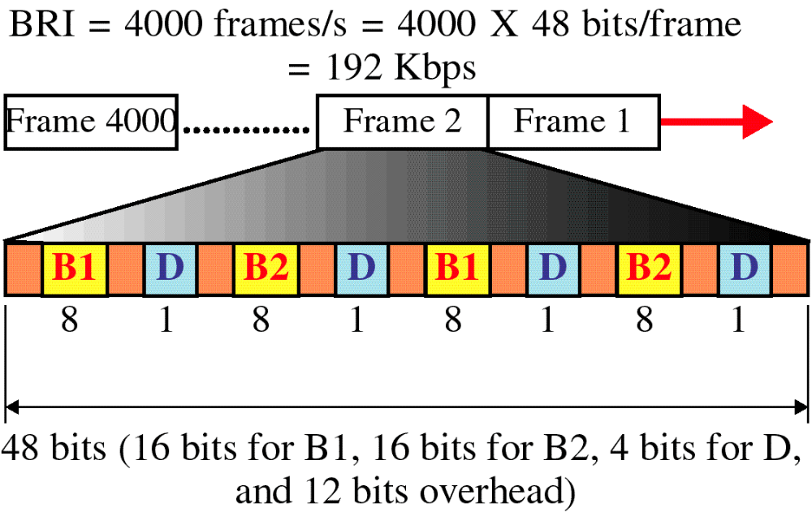
Figure 15-17
BRI Frame
WCB/McGraw-Hill
© The McGraw-Hill Companies, Inc., 1998

Slide 27
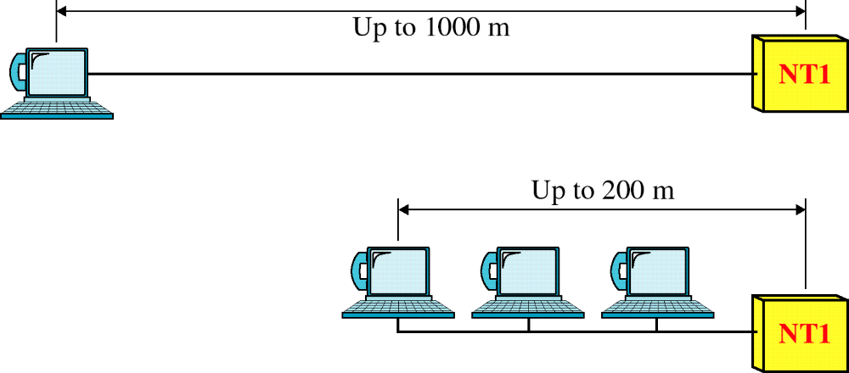
Figure 15-18
BRI Topology
WCB/McGraw-Hill
© The McGraw-Hill Companies, Inc., 1998

Slide 28
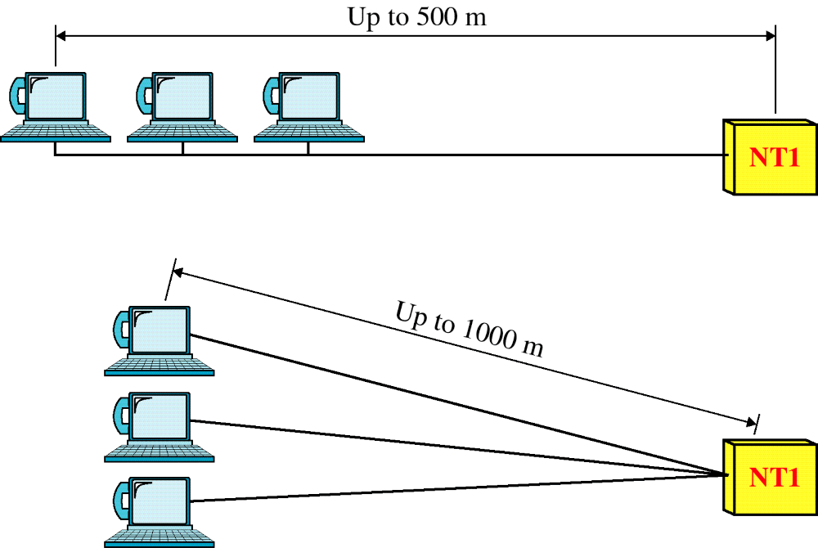
Figure 15-18-continued
BRI Topology
WCB/McGraw-Hill
© The McGraw-Hill Companies, Inc., 1998

Slide 29
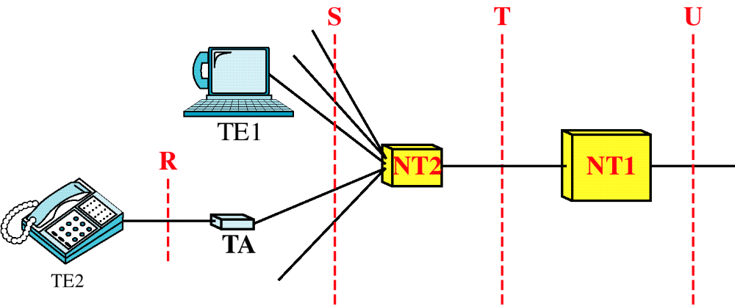
Figure 15-19
PRI Interfaces
WCB/McGraw-Hill
© The McGraw-Hill Companies, Inc., 1998

Slide 30
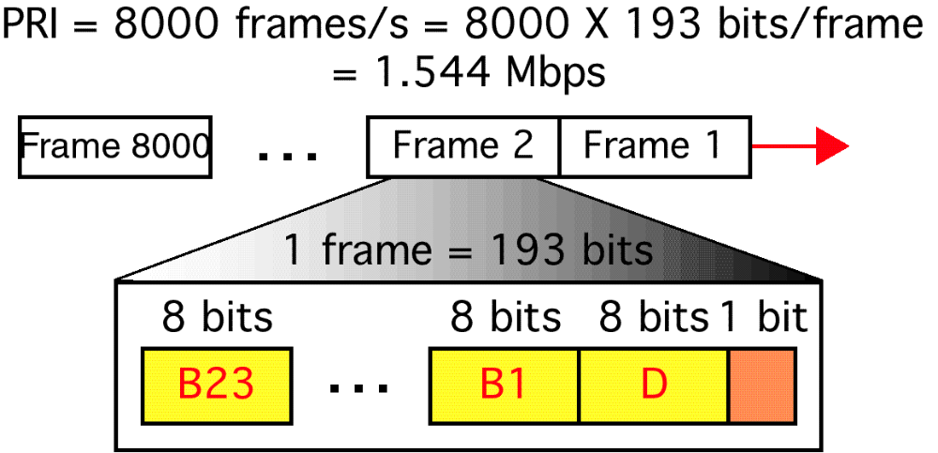
Figure 15-20
PRI Frame
WCB/McGraw-Hill
© The McGraw-Hill Companies, Inc., 1998

Slide 31
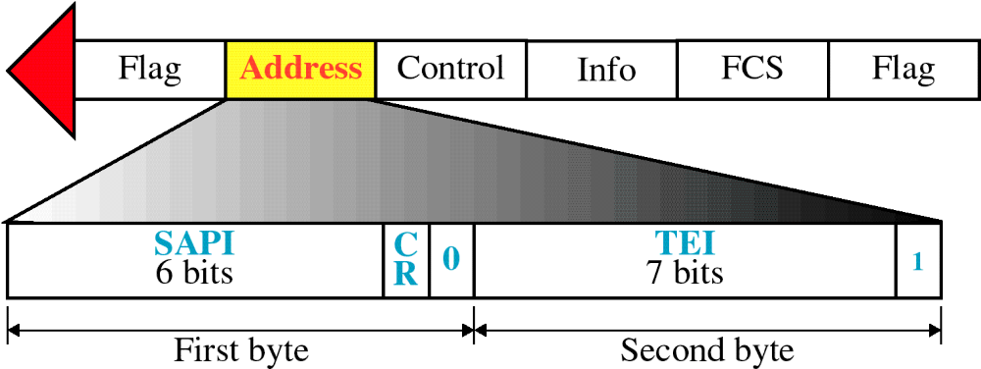
Figure 15-21
LAPD Address Field
WCB/McGraw-Hill
© The McGraw-Hill Companies, Inc., 1998

Slide 32
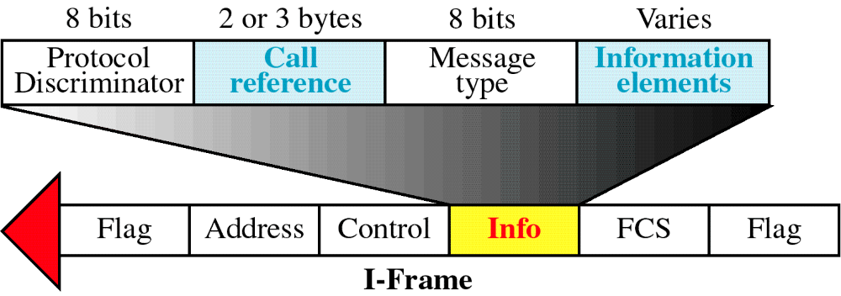
Figure 15-22
Network Layer Packet Format
WCB/McGraw-Hill
© The McGraw-Hill Companies, Inc., 1998

Slide 33
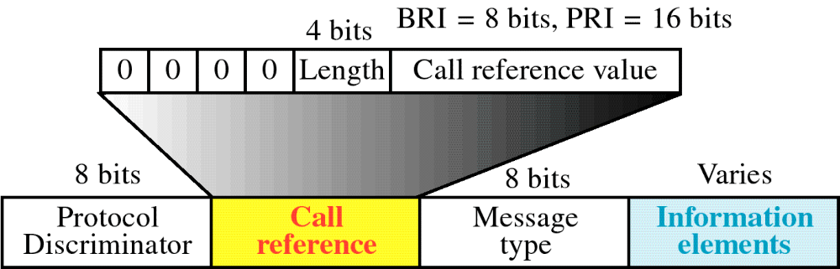
Figure 15-23
Call Reference Field
WCB/McGraw-Hill
© The McGraw-Hill Companies, Inc., 1998

Slide 34
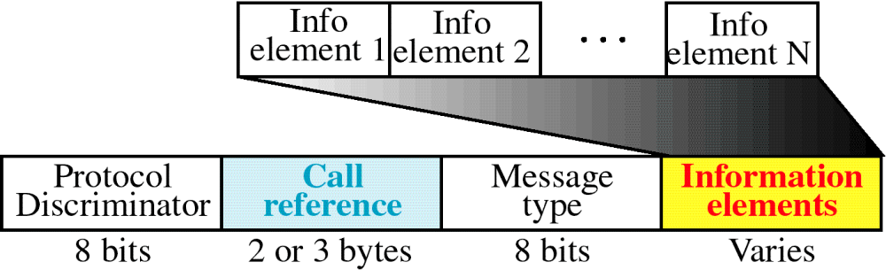
Figure 15-24
Information Elements
WCB/McGraw-Hill
© The McGraw-Hill Companies, Inc., 1998

Slide 35
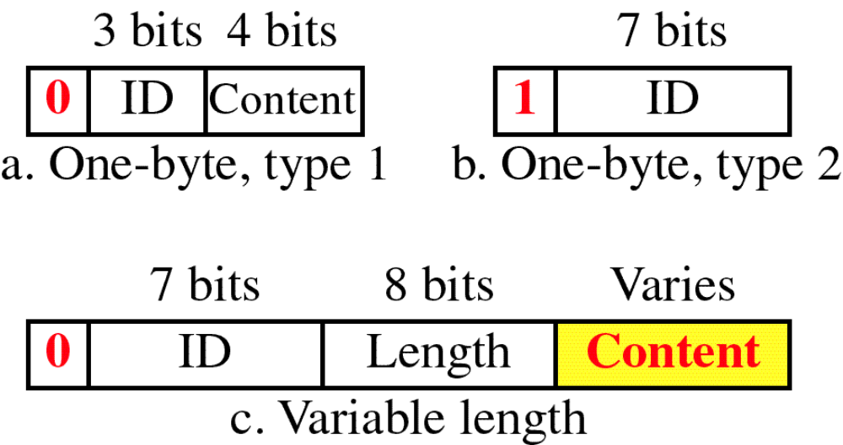
Figure 15-25
Information Element Types
WCB/McGraw-Hill
© The McGraw-Hill Companies, Inc., 1998

Slide 36
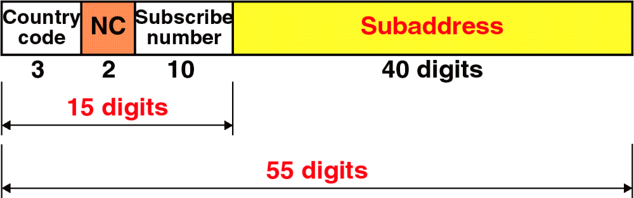
Figure 15-26
Addressing in ISDN
WCB/McGraw-Hill
© The McGraw-Hill Companies, Inc., 1998

Slide 37
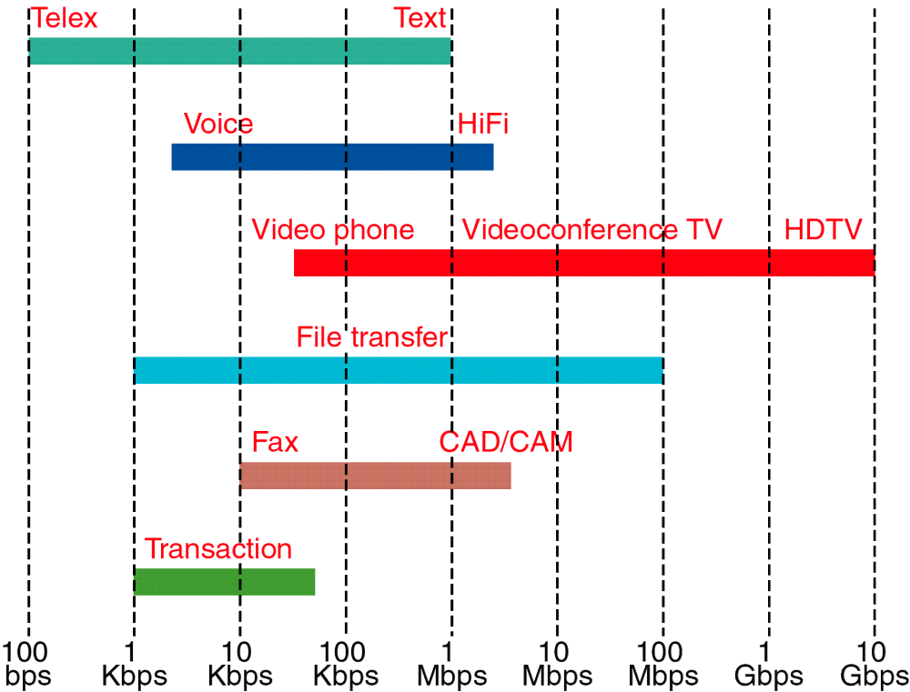
Figure 15-27
Bit Rates for Different Applications
WCB/McGraw-Hill
© The McGraw-Hill Companies, Inc., 1998

Slide 38
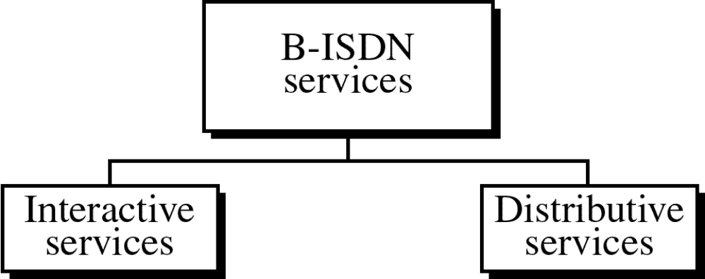
Figure 15-28
WCB/McGraw-Hill
© The McGraw-Hill Companies, Inc., 1998

Slide 39
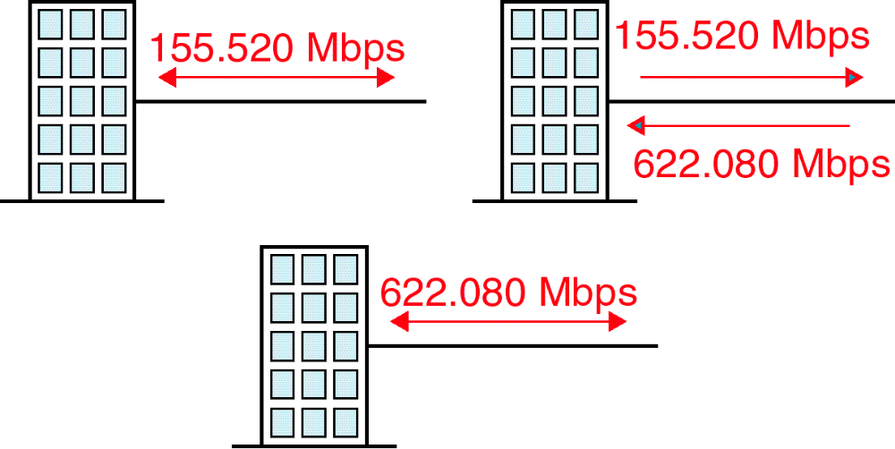
Figure 15-29
B-ISDN Access Methods
WCB/McGraw-Hill
© The McGraw-Hill Companies, Inc., 1998

